Slide 1
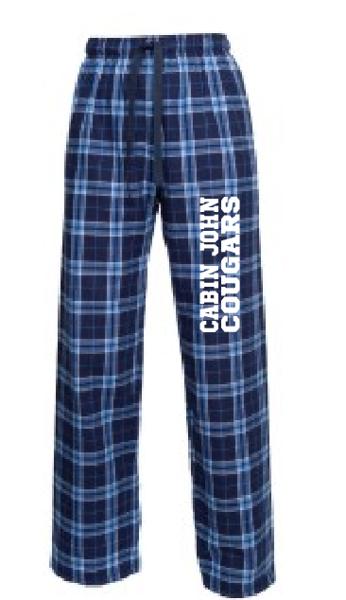
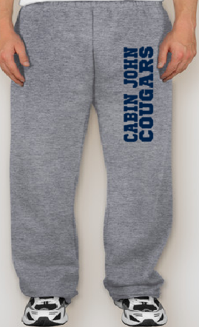
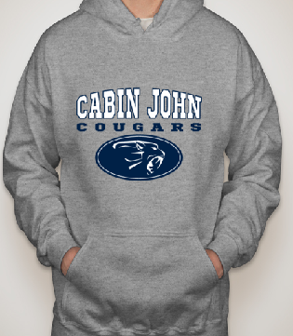
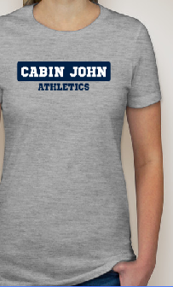
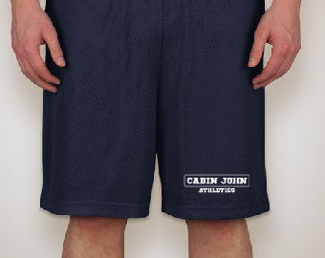
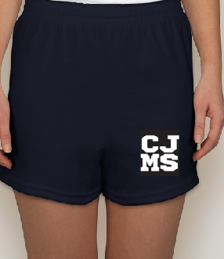
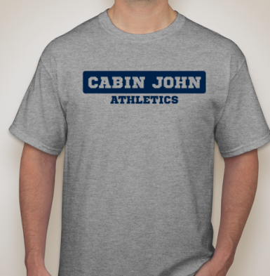
2015/2016 CABIN JOHN SPIRIT WEAR ORDER FORM
Return form with a check to the CJMS Main office in an envelope marked “PTA Spirit Wear”.
We encourage you to order by August 1st to have your items delivered the first week of school! Spirit wear will also be on sale at school events.
Please make check payable to CJMSPTA. Questions? Email Ali@iSparkleEvents.com
STUDENT NAME: _____________________________GRADE (15-16 School Year):________________
PARENT EMAIL:______________________________________________________________________
TOTAL ITEMS:____________________________ TOTAL COST:_________________________________
Unisex Navy Flannel Pants
Open Bottom Sweatpants
Unisex 50/50 Hooded
Sweatshirt
Ladies Junior Jersey T-shirt
Men’s Sport-Tek Mesh Shorts
Ladies Soffe Shorts
Unisex Gildan Ultra Cotton T-shirt

